Slide 1



Qiskit Metal Team #2 Designing Multi-qubit chip through Qiskit metal
Geometry Design
Chip Calculation
Hwan-Seop Yeo
JeongWon Kim
SeungWook Woo
Goeun Baek
(HFSS)
Jaeho Lee
(Q3D)
Notes:
Good morning, In this presentation, I’d like to talk about on-going research, The growth and optical characterization of a site-controlled thee-fold symmetric III-nitride quantum dot grown by MOCVD

Slide 2
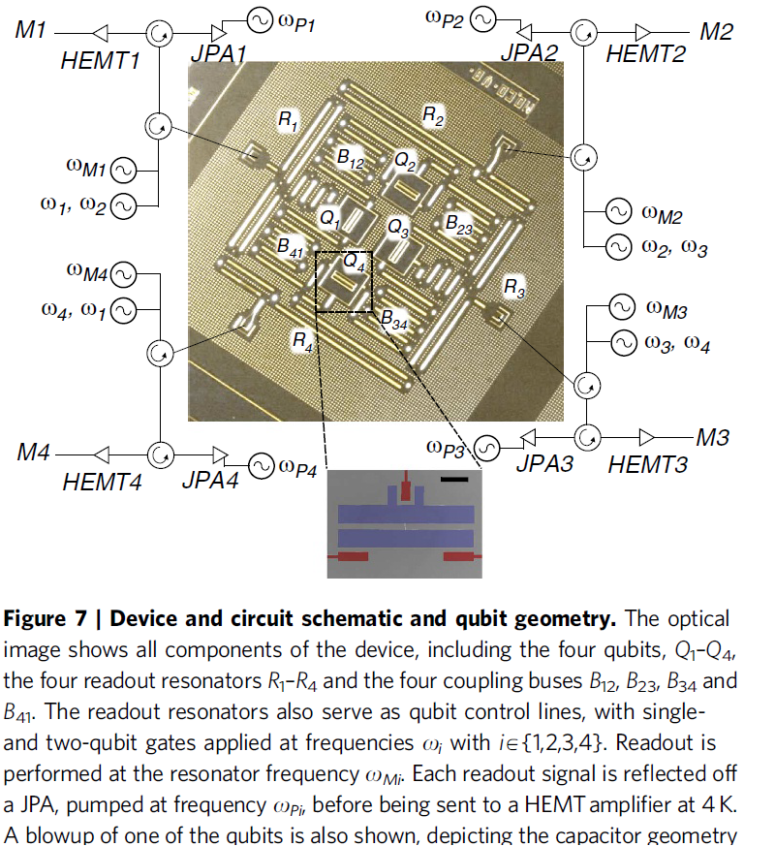

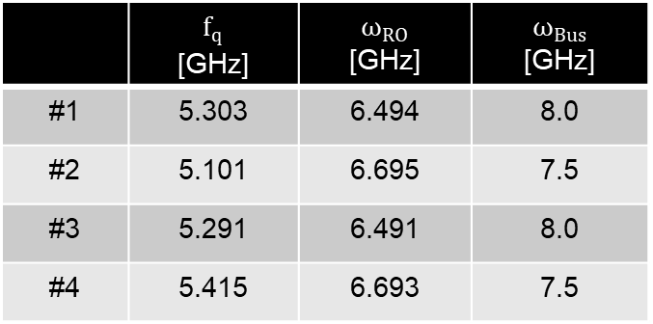
Introduction: Common Work Flow
Superconducting Qubit Chip
Properties
Qubit
frequency
Readout
frequency
Bus
frequency
 | $f_{q}$ [GHz] | $ω_{RO}$ [GHz] | $ω_{Bus}$ [GHz]
#1 | 5.303 | 6.494 | 8.0
#2 | 5.101 | 6.695 | 7.5
#3 | 5.291 | 6.491 | 8.0
#4 | 5.415 | 6.693 | 7.5
?
Transmon Qubit
A.D. Corcoles, Nat. Comm. 6:6979 (2015), IBM

Slide 3
Introduction: Purpose of Hackathon
Superconducting Qubit Chip
Target Properties
Qubit
frequency
Readout
frequency
Bus
frequency
 | $f_{q}$ [GHz] | $ω_{RO}$ [GHz] | $ω_{Bus}$ [GHz]
#1 | 5.303 | 6.494 | 8.0
#2 | 5.101 | 6.695 | 7.5
#3 | 5.291 | 6.491 | 8.0
#4 | 5.415 | 6.693 | 7.5
?
Transmon Qubit
A.D. Corcoles, Nat. Comm. 6:6979 (2015), IBM

Slide 4
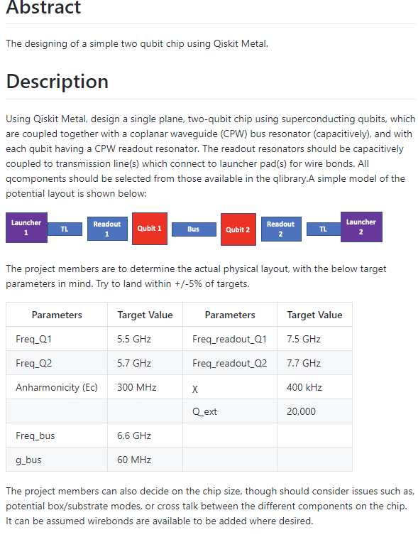
Metal Project 1A: Design a Simple Two-qubit Chip (Target)
Chip geometry
Target properties

Slide 5
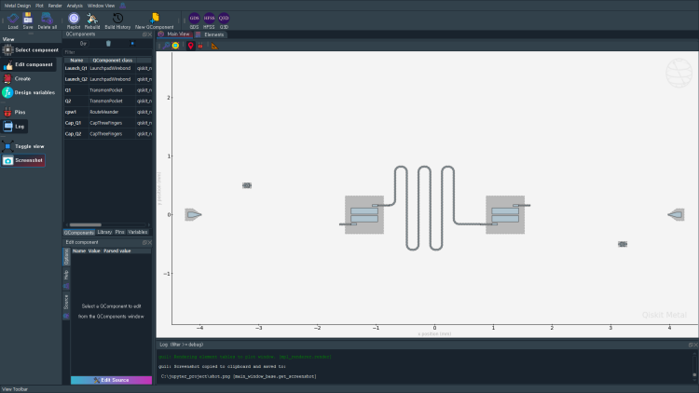
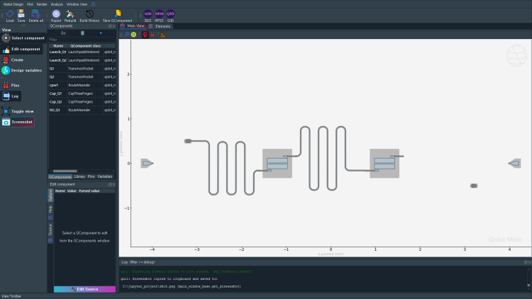
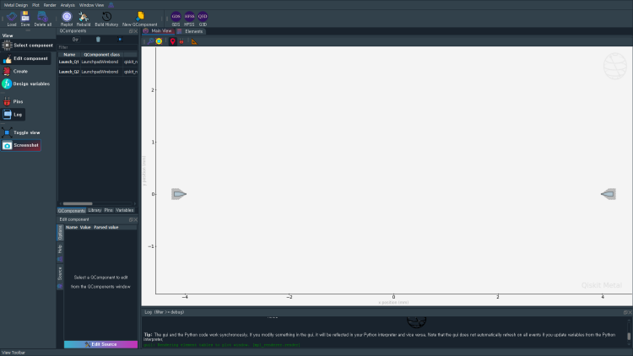
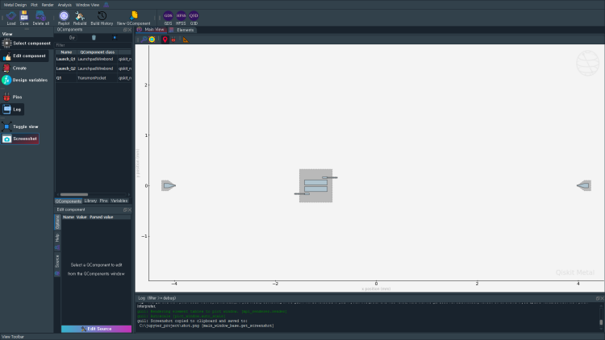
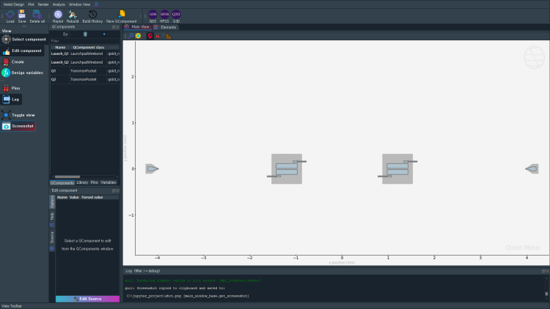
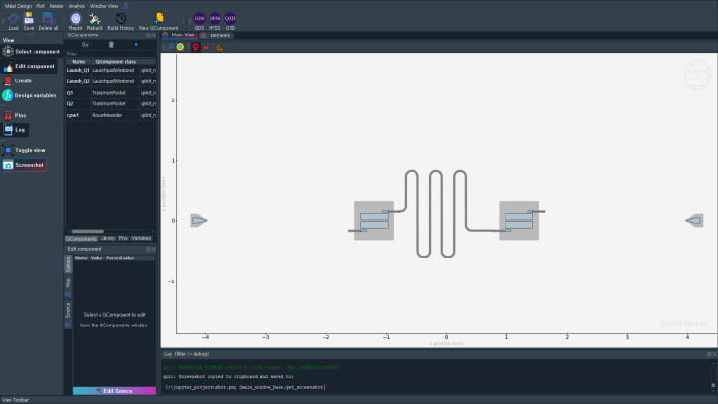
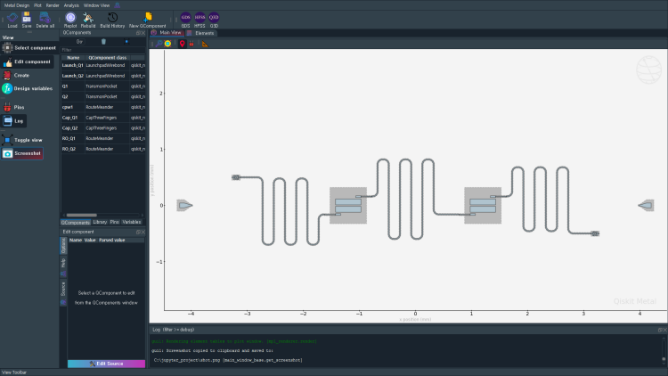
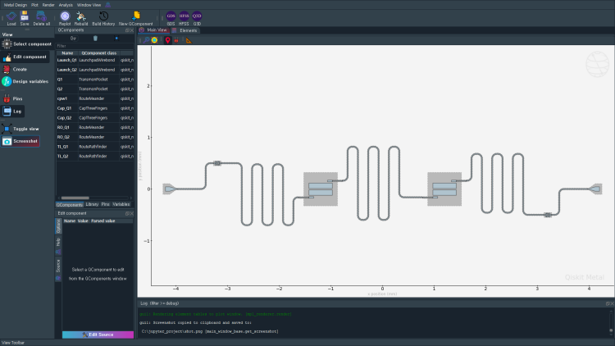
Metal Project 1A: Design a Simple Two-qubit Chip (Result)
Chip geometry (Designed by HSYeo, SWWoo, JWKim)

Slide 6
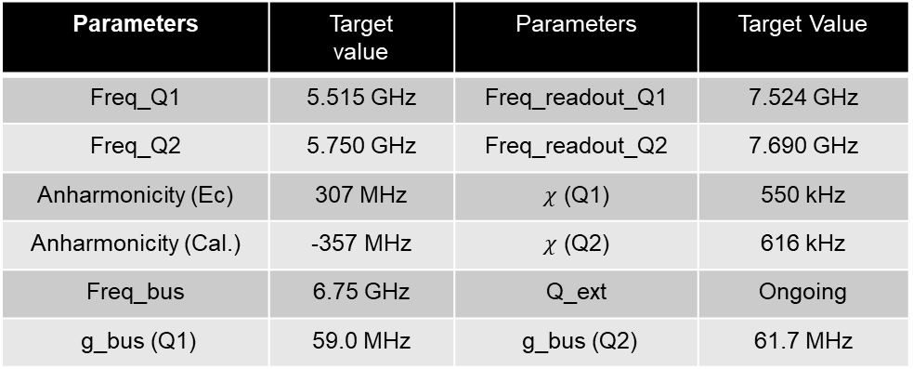
Metal Project 1A: Design a Simple Two-qubit Chip (Result)
Target Properties
Parameters | Target value | Parameters | Target Value
Freq_Q1 | 5.515 GHz | Freq_readout_Q1 | 7.524 GHz
Freq_Q2 | 5.750 GHz | Freq_readout_Q2 | 7.690 GHz
Anharmonicity (Ec) | 307 MHz | $χ$ (Q1) | 550 kHz
Anharmonicity (Cal.) | -357 MHz | $χ$ (Q2) | 616 kHz
Freq_bus | 6.75 GHz | Q_ext | Ongoing
g_bus (Q1) | 59.0 MHz | g_bus (Q2) | 61.7 MHz
Calculated Results

Slide 7
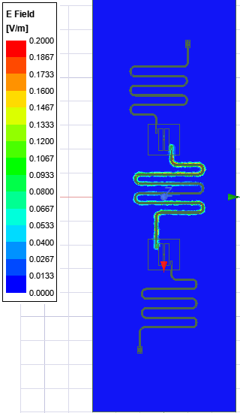
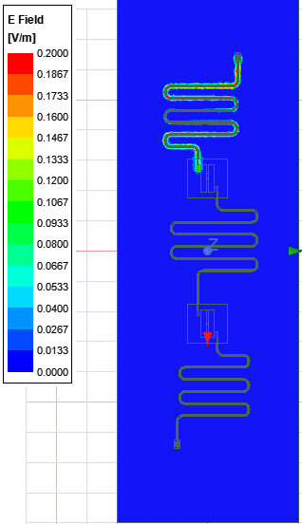
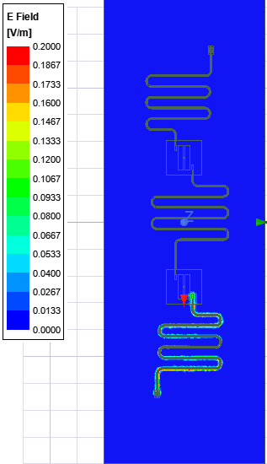
HFSS Results for Resonators (by Goeun Baek)
Mode 1: 6.75 GHz
Mode 2: 7.524 GHz
Mode 3: 7.690 GHz
RO2
Q2
Q1
RO1

Slide 8
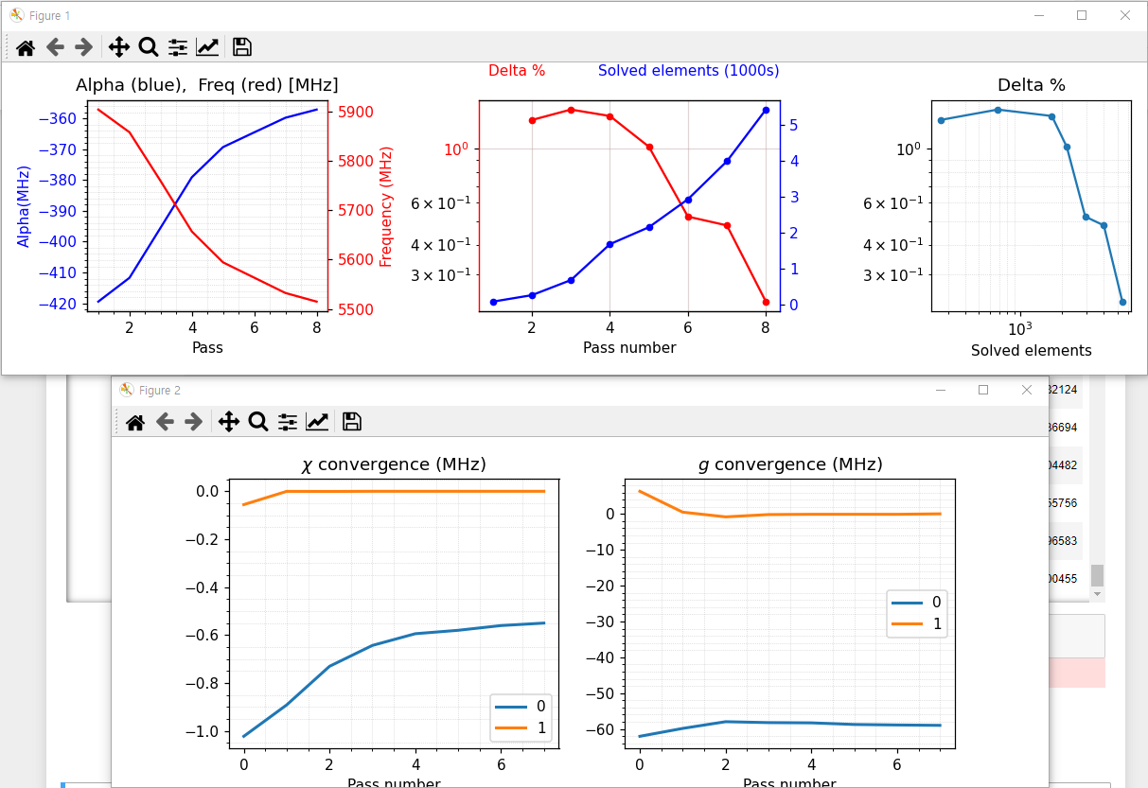
Q3D Results for Q1 in two-qubit chip (by Jaeho Lee)

Slide 9
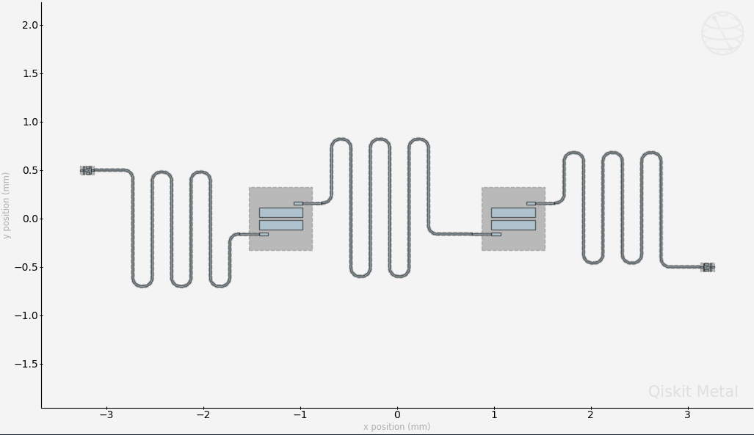
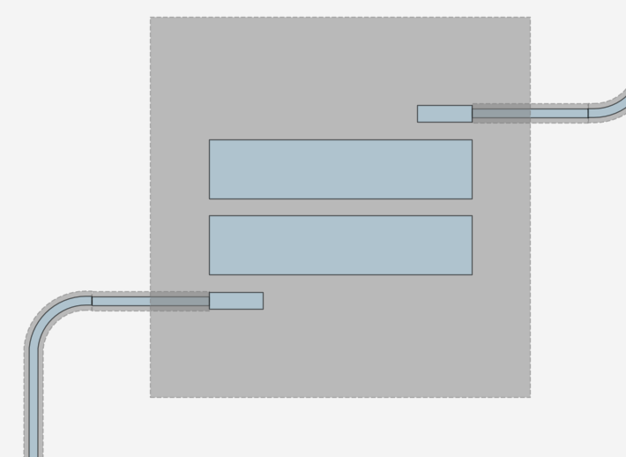
Major Parameters for Target Properties (by HSYeo, JWKim, SWWoo)
Resonator Length
➔ Frequecy
Pad size
➔ Anharmonicity
Connection pads
➔ Coupling strength

Slide 10
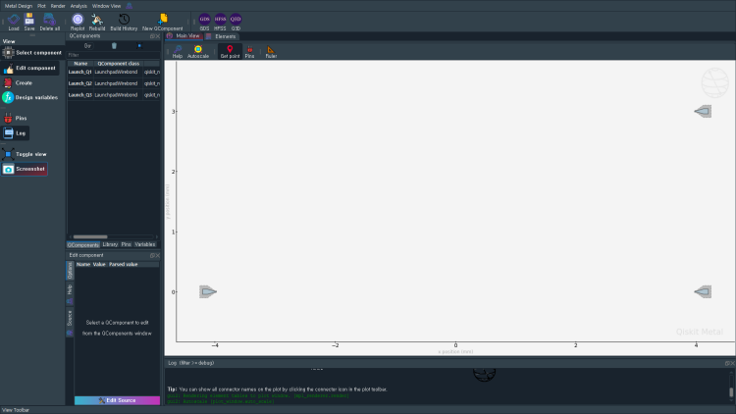
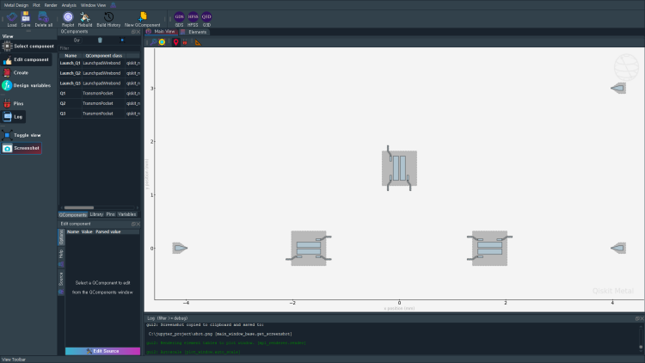
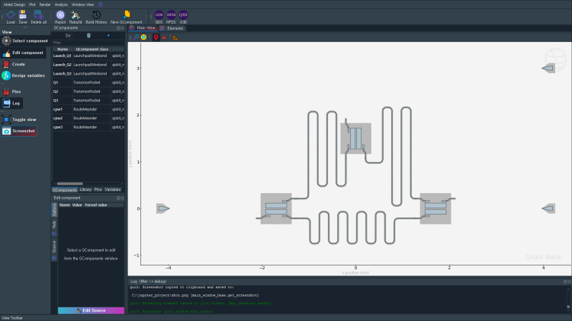
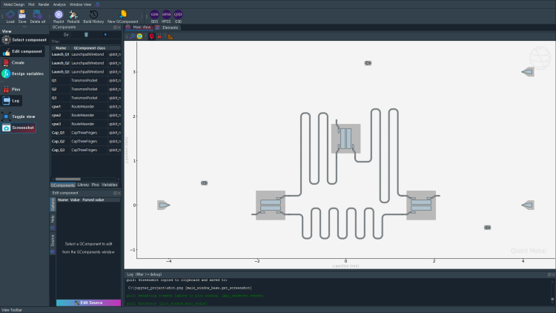
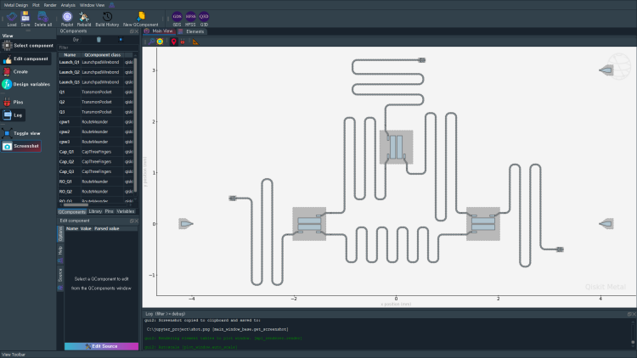

Metal Project 1B: Three-qubit chip?
Chip geometry (Designed by HSYeo, SWWoo, JWKim)
Q3
Q1
Q2

Slide 11
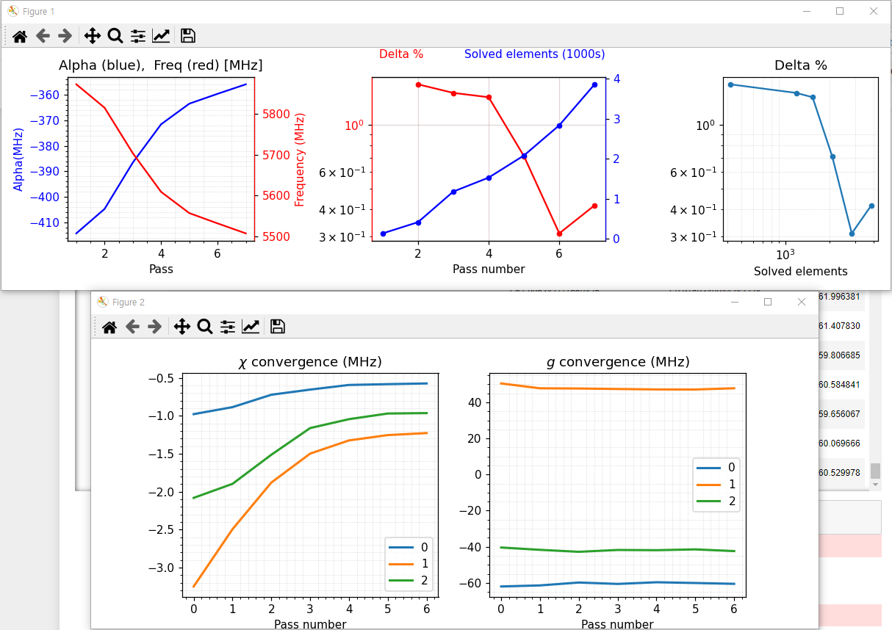
Q3D Results for Q1 in Three-qubit Chip (by Jaeho Lee)

Slide 12
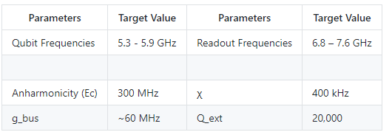
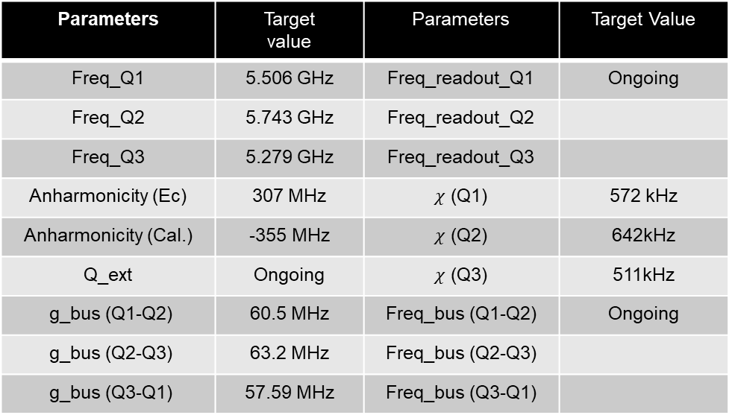
Summary for Metal_3Q
Target Properties
Parameters | Target value | Parameters | Target Value
Freq_Q1 | 5.506 GHz | Freq_readout_Q1 | Ongoing
Freq_Q2 | 5.743 GHz | Freq_readout_Q2
Freq_Q3 | 5.279 GHz | Freq_readout_Q3
Anharmonicity (Ec) | 307 MHz | $χ$ (Q1) | 572 kHz
Anharmonicity (Cal.) | -355 MHz | $χ$ (Q2) | 642kHz
Q_ext | Ongoing | 𝜒 (Q3) | 511kHz
g_bus (Q1-Q2) | 60.5 MHz | Freq_bus (Q1-Q2) | Ongoing
g_bus (Q2-Q3) | 63.2 MHz | Freq_bus (Q2-Q3)
g_bus (Q3-Q1) | 57.59 MHz | Freq_bus (Q3-Q1)
Calculated Results

Slide 13
Thank You!!

